Slide 1
A Mega Project on “Eco-Friendly Product” By
Tanisha Patil - 210943120109
Aparna Sawant- 210943120015
Aparna Sonwane- 210943120016
Trupti Patil- 210943120112
Guided By
Mrs.Harshita

Slide 2
1.INTRODUCTION
The use of Plastic and other non-biodegradable materials had cause several issues. To top, plastic pollution is now the most common environmental problem that humans and animals are both facing so this web based “Eco-Friendly Product” project is an attempt to stimulate the basic concepts of reduce the pollution. The system enables the customer to do the things such as search for Products category wise, choose products based on description and add that product into cart.

Slide 3
1.2.Problem Statement:
Now days, day by day increasing the pollution so people buy the eco-friendly product but such kind of all product is not available on single platform. Hence this system is proposed to overcome the flaws of the existing system .

Slide 4
1.3.Objectives of project:-
To produce a web-based system that allows the customers to buy products online. Admin can view the list of customers, products , categories ,stocks also can add, update and delete the employee , category, and products.
The customer can order products online without being present physically .

Slide 5
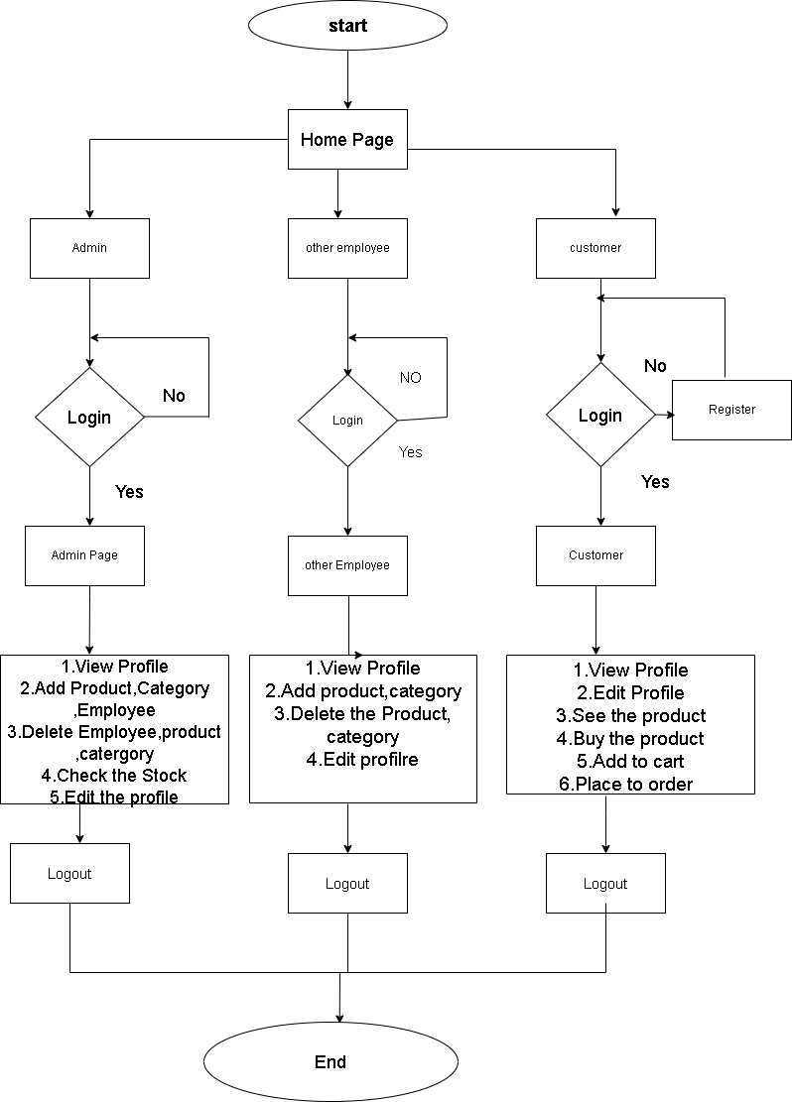
2.1.FLOW CHART:
Fig 2.1 Flowchart of Eco-friendly Product

Slide 6
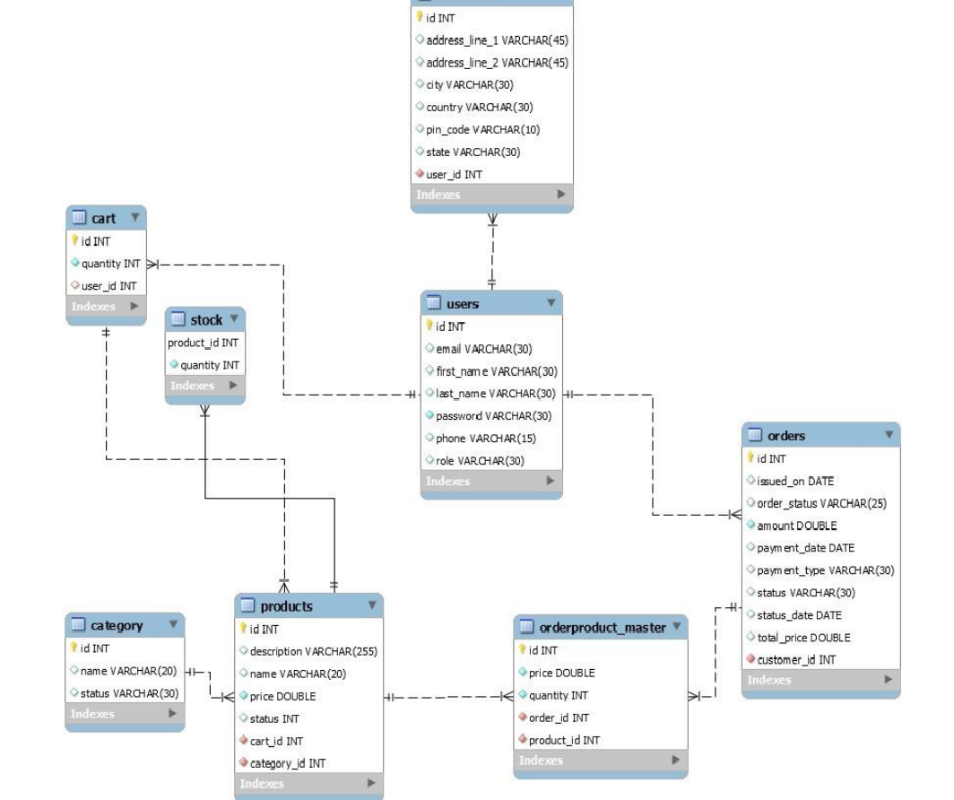
2.2 ENTITY RELATIONSHIP DIAGRAM
Fig.2.2 ER Diagram of Eco-Friendly Products

Slide 7
3.MODULES AND DESCRIPTION:
1.Customer Module
2.Employee Module
3.Admin Module
1. Customer Module
Customer can login or register.
Customer can search for a particular product.
Add products to cart.
Customer can filter products according to their requirements.
Buy products selected in the cart.
Customer can edit the profile.
Customer gives the feedback or contact to admin.

Slide 8
2.Employee Module
Employee can login own account.
Employee can add products ,category for sell and also edit the profile.
Assign the orders to delivery person.
Delivery Person can login own account edit the profile.
Pick up the orders and deliver order to customer.
4.Admin Module
Admin can login.
Admin can see stock.
Track customers and employee activities and data.
Add category of product ,product ,employee ,delivery person.

Slide 9
4.SOFTWARE:
Back End:
1)Framework : Spring Boot
2)Database: MySQL
3)Build Tool: Maven dependencies
Front End:
1)React-Js

Slide 10
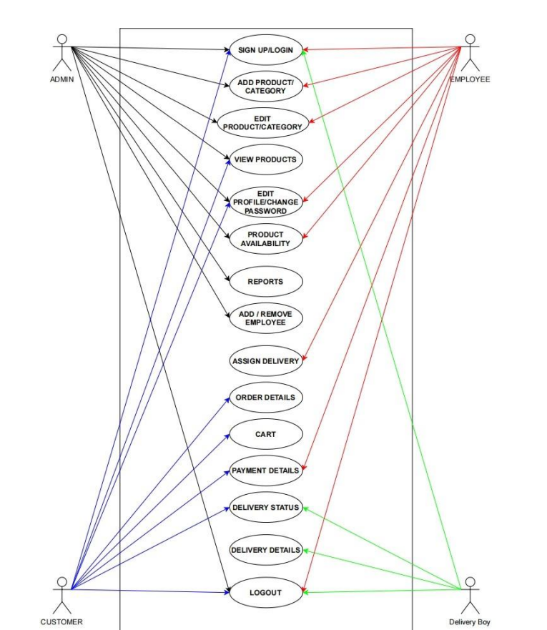
5.UML DIAGRAMS
Fig 5.1 UML Diagrams

Slide 11
6.FUTURE SCOPE
Customer Dashboard
Payment Gateway.
Google Maps API
We can add local vendor

Slide 12
7.CONCLUSION
The ‘Eco-friendly Product’ is designed to provide a web based application that would make searching, viewing and selection of a eco-friendly product easier.
The growing quality demand of eco-friendly products makes it necessary to exploit the interactive online platform efficiently, also to improve the management of order .

Slide 13
THANK YOU!!

